Slide 1
MAVERICK
The Movie Recommendation System
Submitted By:
Suyash Srivastava (191500835)
Shreya Yadav (191500784)

Slide 2
Recommendation System
Recommendation systems produce a ranked list of items on which a user might be interested, in the context of his current choice of an item.
Subclass of Information filtering system that seek to predict the 'rating' or 'preference' that a user would give to them.
Helps deciding in what to wear, what to buy, what stocks to purchase etc.
Applied in variety of applications like movies, books, research articles.
Recommendation systems has mainly two elements Item and User.

Slide 3
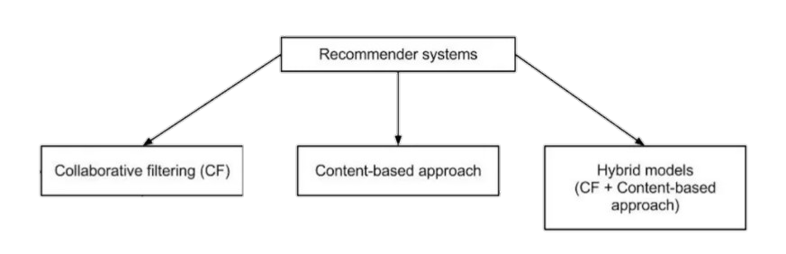

Slide 4
Movie Recommendation System
Content Based: The recommendation system recommends other movies which are similar to that selected movie.
f(movie) → {movies}
2. Collaborative: The recommendation system recommends movies which are rated highly by the similar users.
f(movies, user) → {movies}

Slide 5
Content Based Movie Recommendation System
Content-based methods are based on the similarity of movie attributes. Using this type of recommender system, if a user watches one movie, similar movies are recommended. For example, if a user watches a comedy movie starring Adam Sandler, the system will recommend them movies in the same genre or starring the same actor, or both. With this in mind, the input for building a content-based recommender system is movie attributes.

Slide 6
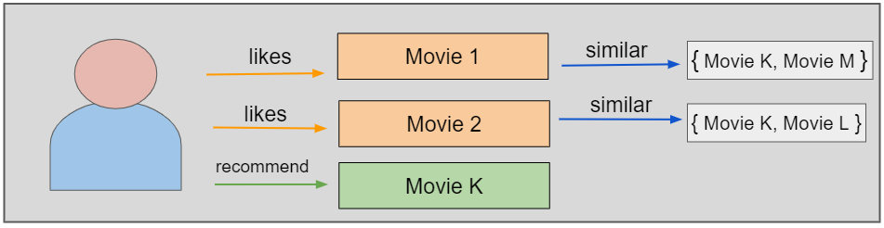

Slide 7
Collaborative Movie Recommendation System
With collaborative filtering, the system is based on past interactions between users and movies. With this in mind, the input for a collaborative filtering system is made up of past data of user interactions with the movies they watch.
For example, if user A watches M1, M2, and M3, and user B watches M1, M3, M4, we recommend M1 and M3 to a similar user C. You can see how this looks in the figure below for clearer reference.

Slide 8
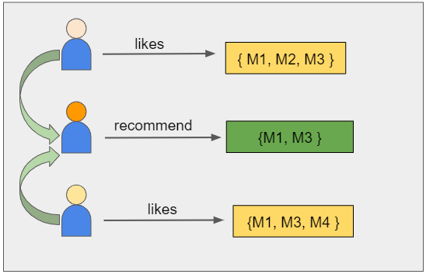

Slide 9
Prediction
Using regression we can solve for the weight vector, W
User can input the movie for which he wants recommendation (say Oi)
We check similarity, S(Oi, Oj) of the given movie with all other movies (Oj).
Each movie's similarity score is dot_product( S, W).
We have to recommend movies which have the maximum similarity Score

Slide 10
Development Tools
Jupyter Notebook
PyCharm (Python IDE)
Kaggle

Slide 11
Jupyter Notebook
The Jupyter Notebook is an open-source web application that you can use to create and share documents that contain live code, equations, visualizations, and text. Jupyter Notebook is maintained by the people at Project Jupyter.
Benefits:
They’re great for showcasing your work. You can see both the code and the results. The notebooks at Kaggle is a particularly great example of this.
It’s easy to use other people’s work as a starting point. You can run cell by cell to better get an understanding of what the code does.

Slide 12
PyCharm
PyCharm is a dedicated Python Integrated Development Environment (IDE) providing a wide range of essential tools for Python developers, tightly integrated to create a convenient environment for productive Python, web, and data science development.
Features
Intelligent Coding Assistance. PyCharm provides smart code completion, code inspections, on-the-fly error highlighting and quick-fixes, along with automated code refactoring’s and rich navigation capabilities.
Built-in Developer Tools.
Web Development.

Slide 13
Kaggle
Kaggle allows users to find and publish data sets, explore and build models in a web-based data-science environment, work with other data scientists and machine learning engineers, and enter competitions to solve data science challenges.
Features
You can learn a lot of technical skills from here ,on Kaggle you can learn from others' work and you can implement it, even i learned a lot of things from Kaggle, so it is the best reference if you are a newbie in Data Science & ML.

Slide 14
Dataset Used
TMDB 5000 Movie Dataset
This dataset was generated from The Movie Database API. This product uses the TMDb API but is not endorsed or certified by TMDb.
Their API also provides access to data on many additional movies, actors and actresses, crew members, and TV shows.

Slide 15
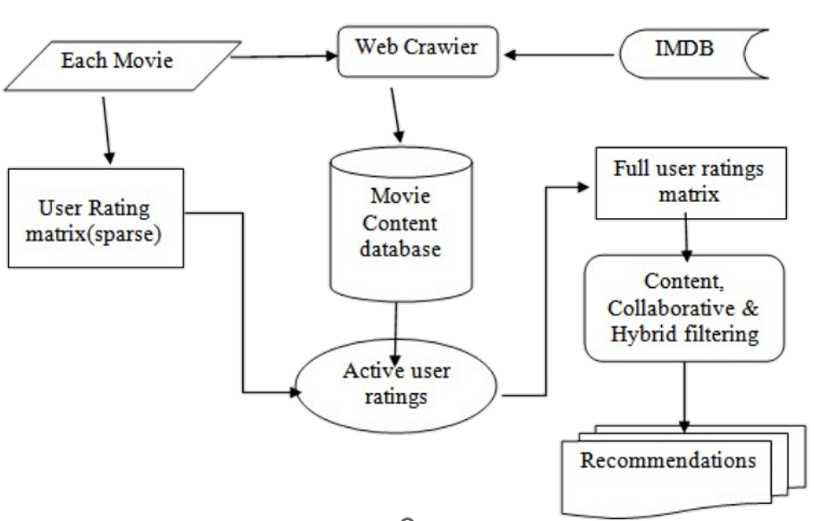

Slide 16
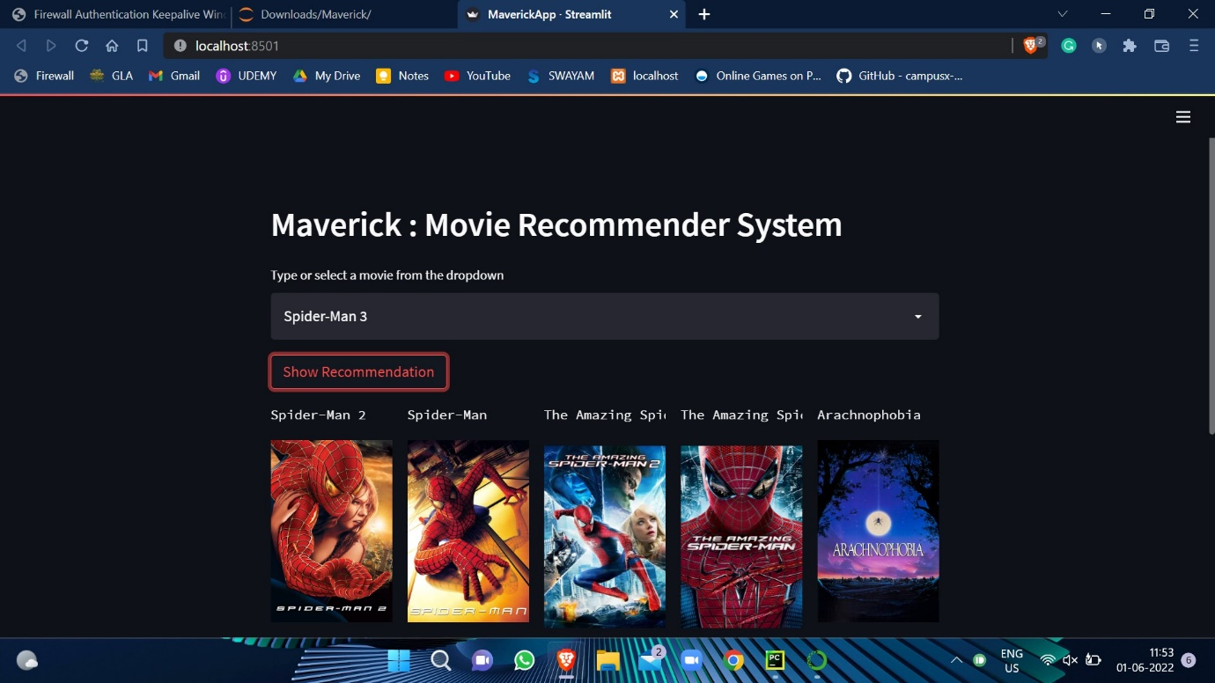
User Interface

Slide 17
Future Work
In collaborative filtering, we have a problem of sparsity of data. Very few users actually rate the same movie.
We can use Clustering Algorithms like K-Means to cluster items or users or both based on their attributes.
In the hybrid approach, we can use more features to get better predictions. (Currently, we have only 9 features)
Deployment of Application upon Heroku.

Slide 18
Thankyou

